Slide 1
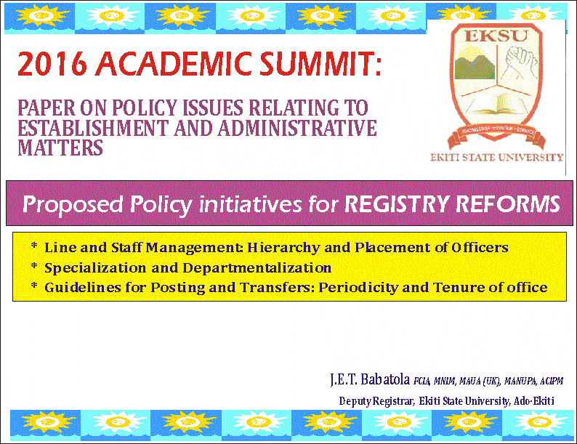

Slide 2
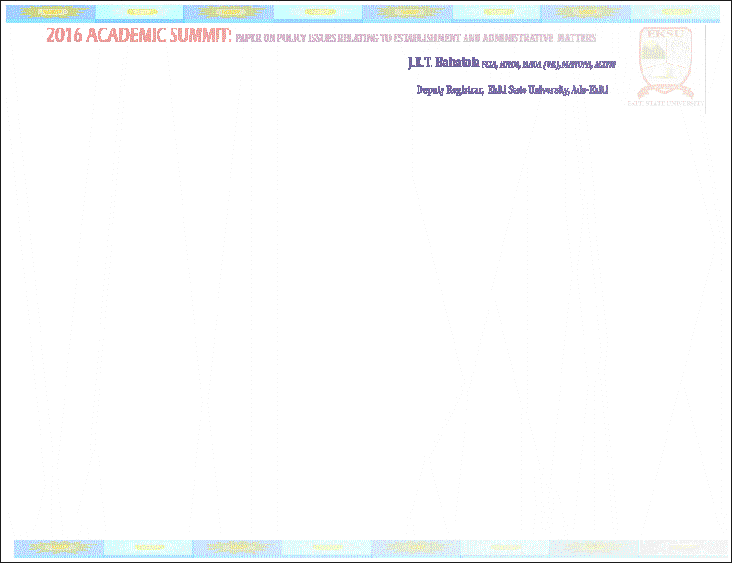
INTRODUCTION:
This paper is addressing some salient policy statements raised in the inauguration speech of 7th substantive Vice-Chancellor, Ekiti State University, Ado-Ekiti - Prof. Samuel Oye Bandele, on 2nd December, 2015. The Vice-Chancellor noted in the said policy document thus:
‘The welfare of staff...will be my priority. Well motivated and happy staff is a potentially productive staff in any organization. I am going to pursue every concern of staff in the areas of welfare with energy and vigour. Promotions will be done as at when and all allowances approved by the University council will be paid with speed and accuracy. The academic summit will look at appointments into duty posts and postings of staff to fashion out a university policy that will ensure equity and respect for professionals and seniority. The latter concerns administrative staff posting, in particular.’

Slide 3
The foregoing statements indicate that the Vice-Chancellor is desirous of generating policy initiatives and much needed guidelines to reform the process of handling establishment and administrative matters bordering on management of expertise, acquisition and development of personnel skills and competencies and the operational efficiency and culture in University administration. Indeed, after 33 years of existence, the University should be able to develop establishment guidelines on appointments and promotions matters with reference to work specialization and departmentalization, posting and transfers, placement of officers and periodicity of staff posting and tenor. This can help to reduce and eliminate possibility of redundancy, unfair practices, favoritism, nepotism, sycophancy, stigmatization, highhandedness and mediocrity fuelled by systemic patronage, personal loyalty and incompetence through jaundiced assessments and parochial interests.
In the University system where the Registry functions as the Secretariat to facilitate the inner workings and administrative processes; best practices and principles must be employed to address and handle establishment matters that bothers on appointment and promotion, work specialisation, departmentalization and organization of administrative functions for Line and Staff Management. For instance, putting the Registry under focal lens and perspectives as a bureaucratic organization in the University performing civil service roles in policy formulation and implementation is helpful for policy initiatives and reforms.

Slide 4
OVERVIEW OF SCHOOL SYSTEM AND ADMINISTRATIVE MANAGEMENT
Effective administrative management of every organization places premium on how to organize and establish its managerial structures and positions ‘‘with assigned authority and responsibilities and procedure for coordinating activity and taking action.’’ The management team consists of executives who normally delegate or assign part of their functions to subordinates while they continuously develop, monitor and oversee the policy framework and processes for the conduct of business affairs and administration of the organization.
Key managers are usually groomed in view of their competencies, suitability and work profile. To some extent, departments in every organization are given a degree of autonomy but they must all work together to accomplish the corporate goals. In listing duties and responsibilities of managers, it is useful to distinguish the functions of each officers and offices to avoid duplicity or compatible functions. People who authorize or initiate transactions may not have custody of assets or be in positions to alter records. Most public sectors of democratic societies including the Universities coordinate their management functions using reliable performance measurements for managerial efficiency as drawn from global best practices for competency testing and career development.

Slide 5
Competencies and placement are regularly premised on work and occupational values such as educational background and academic attainment, the training proficiency and knowledge utility of staff, exposure and leadership qualities developed over a length of time and social recognition and role in the community. University administration like other bureaucratic organizations therefore embraces the use of span of control, hierarchy, technical expertise, training and job responsibilities and unity of command to attain fairness, justness and competence.
AGENDA SETTING: STATE OWNED INSTITUTIONS AS EXTENSION OF PUBLIC SERVICE
The administrative and support staff are traditionally regarded as the University bureaucracy (civil service). Hence, the culture and organization of the Registry must engender building of team spirit and sustaining the universality of academic traditions premised on academic autonomy with validity of skills, intelligence and competence.
The environment of public service in Nigeria has been sustained with the introduction of public service rules and scheme of service to develop standard administrative principles for career progression and service expectations among administrative staff. The tradition of Nigeria’s public service was patterned after the British system and remained largely guided by the experiences of western culture of British and American system.

Slide 6
For all intent and purposes, Ekiti State University, Ado-Ekiti was established by law and the influence of the Government of Ekiti State on the ownership, funding and control of the University makes it an extension of the public service despite the academic autonomy enunciated by the National Policy on Education among others. The Nigerian Constitution also defined all educational institution established or financed principally by government of Nigeria as extension of the public service. Staffs of state owned institutions are therefore regarded as subservient agent of the government carrying out constitutional duties and performing public service functions.
EXTRACT FROM PUBLIC SERVICE RULES ON APPOINTMENT, PROMOTION, POSTING AND PLACEMENT OF ADMINISTRATIVE OFFICERS
The revised 2004 Public Service Rules is a an eye opener for embracing policy options on appointment, promotion, posting and placing of Administrative Officers in the University system. Appointments into public service are made on the authority of the Federal Civil Service Commission for posts graded GL 12-17 as the need arises along with advertised vacancies for post GLS 07-10 and holding of annual public service examinations. For instance, appointments into senior posts in civil service are based on selection from the pool of successful candidates at the Civil Service Examination who must possess honours degree or HND not below Upper Credit as recommended by each Ministry. The Appointments and Promotions Committee undertake similar functions with its variations subject to the approval of the Governing Council in the University.

Slide 7
Determination of vacancies, requirements for appointment and appointments of junior staff are made by each ministry for post GLS 06 and below through a Junior Staff Committee. Similar functions are carried out by Junior Staff Committee in the University subject to the approval of the Governing Council. All appointment and promotions in the Public Service except those of Permanent Secretaries are vested in the Commission.
Transfer is regarded as the permanent release of an officer from one scheduled service to another or from one class to another within the service while secondment is a temporary release for a specified period. The Ministries handles transfer/secondment for posts GL 06 and below. In the case of Junior Staff, transfer may be arranged with consent concerned officers and mutual discretion of the Permanent Secretary while the Commission determines those on GL 07-10 with their 3 years confidential report. Transfer from other one senior post or class to another requires prior approval of the Commission as presented by the Permanent Secretary with the status of work performance on duty, qualification for the new posting and recommendations to justify it.
Whenever a particular post is to be filled where no officer of corresponding substantive rank is available, other officers may act in the duty post and assume fully or partially the duties and responsibilities of the post provided it is approved by the Commission.

Slide 8

However, absence of a substantive holder of a duty post for a short period either casual or sick leave does not justify appointment of any other officer in acting capacity without permission of the Commission since acting appointment is not a suitability or justification to remove the substantive officer.
All promotions are effective only with the Commission’s approval. Hence, all officers must be considered for promotion on the basis of competitive merit among eligible candidates without disciplinary sanctions, provided they meet the minimum criteria in form of qualification/experience, age, training, performance contained in the scheme of service with the minimum years as follows:
GLS 15-17 Minimum of 4 years
GLS 07-14 Minimum of 3 years
GLS 06 and below Minimum of 2 years
In assessing the merit of officers for promotion, there must be clear distinction between their records of performance and efficiency at lower grades and their potentials for promotion to higher positions such as ability and competence to perform the duties and responsibilities of higher positions effectively. Hence, seniority and previous record of performance are taken to account in picking candidates with equal potential for promotion, provided they possess a generally satisfactory record of conduct.

Slide 9
IMPORTANCE OF THE SCHEME OF SERVICE TO APPOINTMENT AND PLACEMENT
The allocation of work and responsibilities differs with attainment of status in the public service in order to identify leadership potentials, motivate and build capacities, reward performance and competence and give access to equity, opportunities and fairness in the work process. The work expectation of administrative officers enunciated by the scheme of service in public service was adopted by the National Council on Establishments w.e.f. 24th October, 2002 and published by the Office of the Head of Service of the Federation in 2003.
The Schemes of Service is a major policy framework guiding public sector organizations and institutions to properly place administrative, executive and technical officers in specific schedule that fits their rank or status. The scheme of service spells out the way and manner in which allocation of responsibilities and positions including posting into offices provided in the Public Service Rules to justify appointment, promotion and posting on the basis of personal merit and competence, reliability, equitable access and fairness.

Slide 10

ADAPTATION OF PUBLIC SERVICE RULES AND SCHEME OF SERVICE IN THE UNIVERSITY TO HANDLE ISSUES OF EQUIVALENCY, POSTING AND TRANSFERS OF ADMINISTRATIVE STAFF
The nomenclatures of administrative officers vary in the Nigerian public service, though it is similar across the University system. In the public education sector, ranking of officers differs despite the use of similar titles and job allocation within the institutional framework. The implication of the foregoing is that work activity, grading and ranking system in the public service are often arranged in consideration of organization’s needs and framework and not by personal preference, choice or sentiments. A thorough examination of Scheme of service of Nigeria’s Public Service would help to determine the pattern of ranking and placement suitable for administrative officers and other officers within the Nigeria’s higher education institutions.
I have devised a table in line with the requirements stipulated in the public service rules, scheme of service and other administrative and statutory guidelines for the study of the equivalency, posting and transfer (placement) of officers in line with the status of their offices, rank and schedules of duties to serve as a guide for reforms in the University Registry as indicated in the table below viz.

Slide 11
EQUIVALENCY TABLE FOR ADMINISTRATIVE OFFICERS IN PUBLIC SERVICE
S/N | Federal Civil Service | State Civil Service, Statutory Agencies and Corporations | Federal & State Universities, Inter-Universities & Research Centres | Federal & State Polytechnics & College of Technology | Federal & State Colleges of Education, Agriculture etc. | Rating of Schedules of duties for posting and placement ratio
1 | Head of Service of the Federation | - | - | - |  | To take charge of the general administration of the Department (Administration of the organization, agency, institution, ministry, commission etc) and advising on general administrative matters.
2 | Permanent Secretary CONSOLIDATED SALARY SCALE | Head of Service of a State | Registrar & Secretary to Council CONSOLIDATED SALARY SCALE
3 | Director GL 17 | Permanent Secretary/ Director General CONSOLIDATED SALARY SCALE
4 | Deputy Director GL 16 | Executive Secretary/ Director GL 16 | Director CONUNASS 15 |  |  | To take charge of a Division/Development(Directorate or Centre), advising on general administrative matters and assisting in general administrative of the department at State level, and taking responsibility for administrative development planning.

Slide 12
5 | Assistant Director GL 15 | Deputy Director GL 15 | Deputy Registrar/ Deputy Director CONUNASS 14 | Registrar & Secretary to Council CONSOLIDATED SALARY SCALE | - | To take charge of a Branch (Division of Registry or Office/ Unit of a Directorate), take charge and coordinate activities in specific subjects, coordinate the training programme of staff, assist in policy formulation execution and reviews and in general administrative development planning.
6 | Chief Administrative Officer GL 14 | Assistant Director GL 14 | Principal Assistant Registrar CONUNASS 13 | Deputy Registrar | Registrar & Secretary to the Council CONSOLIDATED SALARY SCALE | To take charge of a section, take charge of specific subjects and supervise the training programme of staff.
7 | Assistant Chief Administrative Officer GL 13 | Chief Administrative Officer GL 13 | Senior Assistant Registrar CONUNASS 11 | Principal Assistant Registrar | Deputy Registrar | To take responsibility for duties of personnel management, project analysis, investment management, financial management, management services, assisting in the administration of a section, formulation, execution and review of policies and training of junior staff.

Slide 13
8 | Principal Administrative Officer GL 12 | Principal Administrative Officer GL 12 | Assistant Registrar CONUNASS 09 | Senior Assistant Registrar | Principal Assistant Registrar | To prepare annual estimates of revenue and expenditure, perform personnel, financial and general administrative duties, prepare statutory and periodic reports and coordinate activities of a number of junior officers.
9 | Senior Administrative Officer GL 10 | Senior Administrative Officer GL 10 | Administrative Officer I CONUNASS 08 | Assistant Registrar | Senior Assistant Registrar | To initiate the preparation of draft memoranda and speeches, supervise the work of a number of subordinate officers, analyse and apply data and assist in making reports.
10 | Administrative Officer I GL 09 | Administrative Officer I GL 09 | Administrative Officer II CONUNASS 07 | Administrative Officer I | Assistant Registrar | To perform specialized functions in the fields of economic planning, trade and investment, personnel management etc, collate and assist to analyse data, make submissions and prepare draft letters on specific matters.

Slide 14

11 | Administrative Officer II GL 08 | Administrative Officer II GL 08 | Administrative Assistant CONUNASS 06 | Administrative Officer II | Administrative Officer I/II | To perform duties under supervision, collect and interpret data for use by superiors, submit and prepare draft letters on specific matters and prepare minutes of meetings.
OPERATIONAL EFFICIENCY FOR WORK SPECIALIZATION AND DEPARTMENTALIZATION IN THE REGISTRY: THE ORGANIZATION OF DEPARTMENTS WITH RELEVANT HEADSHIP
The proper organization and arrangement of the Registry as the critical arms of the University administration differs across the Nigerian and western universities. However, what it is important is to ensure that the Registry is organized into operational units for efficiency, division of labour and specialization by streamlining of responsibilities and work process. NUC Manual on University Management (June, 1997: 26-33) examined the duties, functions and responsibilities of the Registry. The NUC Manual also stipulated the existence of specialization of work and departmentalization of schedules in the Registry. The NUC arrangements is similar to EKSU position as enunciated with the creation of new Directorates by the Laws of Ekiti State University, Ado-Ekiti (University of Ado-Ekiti: Law 2014 No. 12 of 2014, Government of Ekiti State of Nigeria).

Slide 15
A cursory look at the Directorate System in Obafemi Awolowo University, Ile-Ife indicated that ‘very senior’ Deputy Registrars are appointed as acting Directors of Registry Directorate without Directors and also function in most Universities as Secretaries of Colleges and large scale autonomous academic programmes and centres as shown in Ibadan, Abeokuta and Zaria Universities to mention a few. However, the total number of Directors required to be appointed into mainstream EKSU Registry Directorates either in substantive or acting capacities is yet to be fully implemented as stipulated by the law. This is not the case with Directorates where other Officers of the University functions. At least the following Directorates - Physical Planning, Works and Services, Procurement and Academic Planning and the Advancement Centre have been headed by Coordinators and Acting Directors when there are no substantive Directors in place.
The functional arrangement and activities of the EKSU Registry in comparison with typical schedules of Registry Departments in other Universities sufficiently requires the appointment of ‘senior’ Deputy Registrars to head Registry Directorates created by law. New and upcoming Deputy Registrars ought to head strategic divisions, offices and units of the Registry and in the Directorate system apart from those to be appointed to serve as Secretary to Colleges or large scale Academic Programmes (i.e. DPTP and PTP). For instance, the posting of Deputy Registrars to Faculties (Schools which are lesser than

Slide 16
Colleges) with lesser schedules and importance ordinarily should not arise unless there are no vacancies in major policy schedules and branches of the Registry. The positions that ought to be open for the posting and transfer of senior administrators in the University system should be instructive if they are expected to become future Registrars or stakeholders in the University system, wherever the opportunity avails.
At the same time, there is no reason why superiors in the Registry cannot work with their subordinates in mentoring the younger ones or in working as a team particularly at middle and top management levels if an organization is bigger than the individual and if the University is not a personal business, but an academic institution and official body committed to sharing of knowledge, accommodation of ideas and value thrives.
No doubt, the culture of each University and the role of the Registrar at coordinating and servicing administrative functions differ and often help to determine how the Registry and its specialized units could be involved in University administration. In Ekiti State University, the Registry and functions of its organs are grouped into operational units as shown in the University Handbook (2015:1889-1953) among others. Invariably it is ideal for a University of 33 years of existence to design and adopt a policy framework for posting and transfer of senior administrative officers and other administrative staff in the University to stimulate leadership in career development and management positions.

Slide 17
FINDINGS: OFFICES WHERE DIRECTORS AND DEPUTY REGISTRARS SHOULD BE POSTED IN EKSU REGISTRY AND ADMINISTRATION
A brief assessment on the ranking and status of Directors and Deputy Registrars suggests their placement (transfer and posting) in likely offices indicated below in line with their competencies, suitability, training and order of seniority (where required or applicable):
Office of the Vice-Chancellor (currently has a Deputy Registrar).
Office of the Registrar (currently has a Deputy Registrar on sabbatical).
Directorate of Personnel Affairs (currently headed by a Director):
1. ESTAB. ACADEMIC AFFAIRS DIVISION (currently has a senior Deputy Registrar)
2. ESTAB. NON-ACAD. SENIOR DIVISION (currently has a Deputy Registrar).
3. ESTAB. JUNIOR DIVISION (currently has a Principal Assistant Registrar)
4. STAFF TRAINING & DEVELOPMENT UNIT AND INDUSTRIAL RELATIONS, PENSION & GRATUITY UNIT (was merged with Gen. Admin. Div. respectively but non-
functioning)
Directorate of Academic Affairs (currently headed by a Director)
1. ACADEMIC & SENATE MATTERS OFFICE (currently has a Deputy Registrar)
2. ADMISSIONS OFFICE (currently has a ‘senior’ Deputy Registrar)
3. EXAMINATIONS & RECORDS OFFICE (currently has a Deputy Registrar)

Slide 18
4. ACADEMIC SUPPORT SERVICES (TRANSCRIPT) AND RECORDS
MANAGEMENT UNIT (currently under Exams & Records)
5. CERTIFICATES AND VERIFICATIONS MATTERS (currently under Admissions
Office)
Directorate of Legal Matters (currently headed by a Senior Deputy Registrar instead of
Director)
Directorate of Council Affairs (currently without a designated Director)
1. COUNCIL AFFAIRS DIVISION (currently headed by a Deputy Registrar)
2. GENERAL ADMINISTRATION DIVISION (currently headed by a Deputy Registrar,
but ought to be headed by a Principal or Senior Assistant Registrar)
Directorate of Student Affairs (currently headed by a Deputy Registrar instead of a Director)
1. STUDENTS CLEARANCE, RECORDS AND NYSC MOBILIZATION
2. STUDENTS’ ORIENTATION, GUIDANCE AND COUNSELLING MATTERS
3. STUDENTS DISCIPLINE, ACADEMIC PRIZES AND BURSARY MATTERS
4. STUDENTS ACTIVITIES, MUNICIPAL SERVICES AND WELFARE MATTERS
Directorate of Information and Corporate Affairs (currently headed by a Deputy Registrar – Information instead of Director) - handles Media and Public Relations, Publications, Information Services, Passages, Protocols, Corporate Affairs and NYSC Matters
College of Postgraduate Studies (currently has a ‘senior’ Deputy Registrar as Secretary).

Slide 19
College of Medicine (Currently has a ‘senior’ Principal Assistant Registrar as College Secretary instead of a Deputy Registrar).
Directorate of Continuing Education Programmes (currently has a Deputy Registrar as Secretary).
Directorate of Part Time Programmes (currently has a Deputy Registrar as Secretary).
Directorate of Distance Learning (currently has a Deputy Registrar as Secretary instead of a Principal or Senior Assistant Registrar).
Directorate of Pre-Degree Programmes (currently having a ‘Senior’ Deputy Registrar as Secretary instead of a Principal or Senior Assistant Registrar).
Office of Research and Development (Currently having a ‘senior’ Principal Assistant Registrar as Secretary instead of a Senior Assistant or Assistant Registrar)
Centre for Gender Studies and Development (currently having a junior Administrator as Secretary instead of a Senior Assistant or Assistant Registrar).
Entrepreneurial Centre (currently having a junior Administrator as Secretary instead of a Principal or Senior Assistant Registrar).
RECOMMENDATIONS:
A. Administrative Officers and Assistant Registrar posting should be regarded as training ground to acquire work knowledge and develop their capacity for future managerial challenges using following criteria viz.

Slide 20
1. Posting/transfer at the level is a matter of regular exposure, mentoring and round tripping to different activities across the offices of the University to enable officers to familiarize with inner workings of different offices of units/sections, departments and cost centres
3. Posting/transfer should be based on transfer to different units of incompatible activities in the University at an average of 1-3 years to enable officers to acquire work experience and knowledge to equip them for middle level managerial skills and responsibilities.
4. An Assistant Registrar may be posted to act as Secretary of Departments, Institutes or small scale academic centres of excellence and to serve as Assistant Secretaries of University Committees.
B. Senior Assistant Registrar and Principal Assistant Registrar posting should be regarded as entry level into the middle level management cadre and training exposure for officers to acquire much needed competence, temperance and personality required for future leadership roles using following criteria viz.
1. Posting/transfer at the level should be a matter of specific assignment, special needs or rotation of office among officers in the cadre to enable them to work with senior academics and very senior administrators either as Faculty Officers and Secretaries of Faculties, Schools, Directorates, Units and cost centres in order to expose and mentor them for management and leadership strategies.

Slide 21
2. Posting/transfer should be seen as an opportunity to serve as serve as a coordinator of an administrative unit in core administrative departments, offices or cost centres during an average period of 2-3 years to enable officers to stabilize and acquire relative work experience and knowledge for higher positions of responsibilities in the future.
3. A Senior Assistant Registrar can be posted out as Faculty Officer in acting capacities and can serve as Secretaries of ad-hoc University Committees or while a Principal Assistant Registrar should be deployed as heads of Units in a Division of Registry in substantive capacities or heads of Divisions in acting capacities; as Faculty Officers or Secretary of Academic Programme and can serve as Secretaries of Boards and Under Secretaries of major University Committees.
C. Deputy Registrars should be regarded as an entry level into the top level management cadre for administrative officers and posting should be as head of Divisions and Offices of the Registry, Secretary of Colleges and major Academic Programmes based on the suitability of these officers to handle task, provide supervisory and strategic leadership roles using following criteria viz.
1. Posting/transfer at the level is a matter of acquired skills, specialization and suitability and rotation of officers in the cadre to enable them to work with as heads of Divisions and Administrative Units of the University and to provide managerial support for effective coordination of the core administrative divisions, departments, office etc.

Slide 22
2. Posting/transfer should take place from 1-5 years to enable officers to retain a sense of belonging and stability at such level for the sustenance of administrative culture.
3. A Deputy Registrar should not be deployed as Faculty Officer (except as Secretary of a College, an Academic Programme or head of a Registry Division, autonomous Unit or Office of the Registry while a Deputy Registrar may act as the head of a Registry Directorate if no Director is appointed into such status, provided he had served as a Deputy Registrar for a minimum of 2-5 years.
D. At the level of Director, posting should be in line with other Officers of the University. However, Directors appointed to head Directorate of the Registry established by law or those approved by Council for other non-academic Directorates should continue in office at the pleasure of the University Management based on their years of service, suitability and capability to provide leadership in any administrative unit like the Information Directorate and Advancement Centre etc.
CONCLUSIONS: Kathy Fowler (2005) noted that ‘we live and work in a rapidly changing environment, and yet higher education in some ways is in itself a highly conservative system…much of the academic endeavour which is at the core of higher education business is about seeking out the new…Much of the change which universities have to undergo operates within this paradigm of apparently constant change within immovable objects.’’ We must agree that expansion is a result of need to develop or multiply.

Slide 23
There can be adequate room for effective performance of work wherever there are creation of new and autonomous units and offices to handle work process in pursuits of University objects. Hence, the Registry must consistently give room for self reappraisal, assessment and adoption of far reaching visionary agenda that promotes good leadership and strategic management.
The schedule of Registry obtained in most Nigerian Universities are similar and Deputy Registrars in average Universities i.e. University of Ibadan, Federal University of Technology, Minna etc qualifies for some perquisites of office such as office allocation, official/project vehicle with driver, secretary, administrative officer, experienced executive officers and clerks. These administrative requirements should not be awarded or rewarded on the platforms of personal relationship but as a standard and office requirements for Deans and Heads of Department (Academic and Non-Teaching) including Directors and Deputy Registrars. Such perquisites of office were witnessed in the early days of this University and up to recent years, but largely absent today due to limited financial resources and policy inconsistency.
It is necessary to look at the possibilities of reforms in EKSU Registry by making policies on appointment and placement of staff into offices to foster equity and fairness. We should give room for access and opportunities to officers appointed into same rank to maximize their potentials by empowering them in positions of responsibility to eliminate redundancy and whittling down of administrative principles.

Slide 24
Professionalism within the global context of Registry is still far cry with reference to departmentalization and work specialization in Nigeria’s Higher Education Institutions. It is a food for thought for another day towards if total quality transformation of the Registry is envisaged for a more rewarding and meaningful career.
J.E.T. Babatola
Deputy Registrar,
Ekiti State University, Ado-Ekiti

Slide 25


